Slide 1
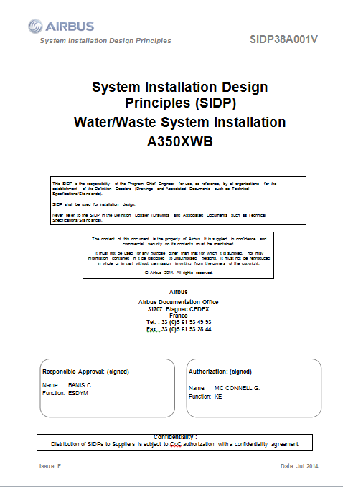
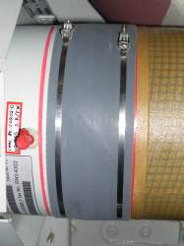
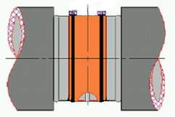
Rule traceability & design check
DRAFT
Traceability
Check

Slide 2
Problem statement & objectives
DRAFT
Model and manage the design rules: since SIDP (design principles) are todays kinds of natural language requirements and explanations:
not all the rules can be directly formalized in a way to be used to verify the design
rules are spread over various products/programs
rules evolve
rules are complex artefacts made of text and picture and tables….
This problem is the one we have been considering primarily in the scope of ModelWriter, trying to define a rule model and knowledge base
Enable mapping between rule model and design model, in order to automate identification of conflicts between rules and design, and then automate analysis of the impact of changes in rules or in design.
This 2d objective we think cannot be reached in the frame of Modelwriter because of the challenge of mapping 3D design models to the BOM … and because lack of skills and data in the context of the project
BUT to be consider to make the system amenable for formal analysis

Slide 3
Problem statement & objectives
DRAFT
(1) Manage rules/design principles and improve traceability
Easier search/retrieval of rules | save costs/time by supporting DP consultation / retrieval in accordance to the needs
Easier change impact analysis at rules level | save DP updating costs/time avoid non-compliance of design caused by DP updating lead time
Easier traceability between artefacts (BOM DB, design models, CAD models…) | keep traceability from upstream regulations to requirements and to downstream design models
(2) Automate identification of design conflicts against rules
Easier consistency checking of the design (CAD) data | Save time to retrieve applicable rules avoid non-compliance of design wrt rules

Slide 4
Solutions explred in MW
DRAFT
 |  | 1 | 2 | 3 | 4
Use a Component taxonomy (BOM) as a reference to annotate rules (rules as Text part / Taxonomy as Model part) | MW synchronization mechanism to help annotation management | + | + | - | -
Extend first approach to other artefacts/models | MW synch between several artefacts | - | - | + | +
Add semantics to BOM to enable reasoning | MW synch | + | + | +
Model rules written in natural language by formalizing the rules in description logic / ability to dynamically update the BOM/component ontology and apply some checks on design rules | MW writer part features that LORIA developed so far in the formalization process + MW synch |  |  | + | +
Model rules written in natural language by formalizing the rules in relational logic | MW writer part + Tarsky part + Synch mech |  |  | + | +
1=Rule retrieval – 2=Rule change – 3= traceability – 4=design check

Slide 5
DRAFT
UC-FR-03 - Synchronization of Regulation Documentation with a Design Rule Repository
Anne MONCEAUX
Airbus Group Innovation

